Slide 1

SDEV1701
Day 14 Flexbox Part II

Slide 2

Today’s focus
Welcome to Day 14! Today we’re going to:
Explore advanced Flexbox properties: flex-direction, flex-wrap, and how to combine them
Learn how to build flexible, responsive rows and columns
Use the calc() function for layout math in CSS
Practice adapting layouts for different screen sizes using Flexbox

Slide 3
Flexbox Continued

Slide 4
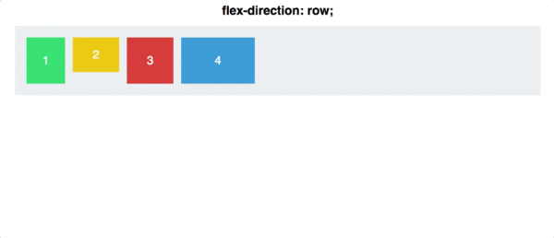
flex-direction
This property controls the direction of the main axis:
row (default): left to right
row-reverse: right to left
column: top to bottom
column-reverse: bottom to top

Slide 5
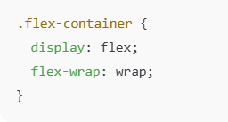
What is flex-wrap?
By default, Flexbox tries to fit all items in one line — even if they don’t fit and end up squishing!
The flex-wrap property tells the browser what to do when items overflow the container:

Slide 6
What is flex-wrap?
Values:
nowrap (default): All items stay on one line.
wrap: Items wrap onto multiple lines if needed.
wrap-reverse: Like wrap, but items wrap in the opposite direction.
✅ Use wrap when you want your flex items to behave responsively — especially useful on smaller screens.

Slide 7
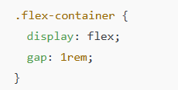
What is gap?
The gap property adds even spacing between items inside a flex container.
This creates equal space between all items, both horizontally and vertically (if wrapped).

Slide 8
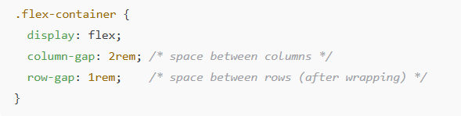
What about column-gap and row-gap?
You can also control gaps individually:

Slide 9

What about column-gap and row-gap?
Or use shorthand.
This gives you more control over layout spacing — no need for margin hacks.

Slide 10

What is the calc() function?
The calc() function in CSS lets you perform math right inside your styles. This is useful when you want to create layouts that are both flexible and consistent.
Example:

Slide 11
What is the calc() function?
What’s going on here?
You have a container that’s 100% wide.
There are 4 cards per row.
There are 3 gaps between the 4 cards, each 1rem wide (so total 3rem gap space).
calc((100% - 3rem) / 4) means:
➤ Subtract the space used by the gaps from the full width,
➤ Then divide the remaining space equally among the 4 cards.
This makes your layout fluid and responsive, without needing to hardcode pixel sizes.

Slide 12
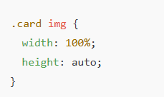
Making Images Responsive
To make images shrink and grow with their container, use this combo:
This tells the image to fill the width of its parent (the .card)
The height: auto keeps the image from stretching or squishing

Slide 13

Important Note:
Don’t set image width and height in your HTML (like this):
Why not?
Those numbers are in pixels and will override your CSS styles, preventing the image from resizing correctly.
Instead, leave the size out in HTML, and use only CSS to control the dimensions.

Slide 14
Summary and Reflection

Slide 15
Reflection Prompt
What is one key takeaway about advanced Flexbox properties?
How will you use Flexbox in responsive design?

Slide 16
Homework
Coding Exercise: Create a fully responsive layout using Flexbox.
Practice with Flexbox Games

